Slide 1


Department of Artificial Intelligence and Data Science
AI SHOPPING WEBSITE
VENKATA SAI V
(221801060)
PRAVEEN B
(221801503)

Slide 2
Problem Statement
Online shopping platforms face significant challenges in delivering a personalized and efficient user experience. Shoppers often struggle to find relevant products quickly, leading to decreased satisfaction and higher cart abandonment rates. Additionally, many shopping websites lack immediate, 24/7 customer support, which can further frustrate users when they need assistance or product recommendations.

Slide 3
Objectives
To create an AI-supported shopping website that offers personalized product recommendations and real-time assistance through an AI chatbot. This platform will enable users to browse, search, and purchase products with ease while receiving instant support for any inquiries, thereby enhancing the shopping experience and increasing customer satisfaction and retention.

Slide 4
Abstract
By integrating AI-driven features, this project seeks to address common issues in e-commerce, such as high cart abandonment rates and low customer engagement, ultimately creating a shopping environment that is more engaging, responsive, and tailored to individual user needs.

Slide 5
Introduction and Overview of the Project.
The project is an AI-enhanced shopping website designed to provide a seamless and personalized user experience by integrating a chatbot that offers real-time assistance and recommendations. This platform allows users to easily browse, search, and purchase products, while the AI chatbot helps answer product-related questions, suggests items based on user preferences, and supports the checkout process. By addressing common online shopping challenges, such as difficulty in finding relevant products and lack of immediate customer support, the project aims to enhance customer satisfaction, reduce cart abandonment rates, and create a more interactive, efficient shopping environment.

Slide 6
LITERATURE REVIEW
S.No | Author Name | Paper Title | Description | Journal | Volume/ Year
1. | A. Gupta, D. Kumar | AI-Powered Personalized Shopping: A Review of Recent Advances | This paper offers an overview of AI techniques for product recommendations and personalized shopping, highlighting challenges and future directions. | International Journal of Computer Science and Engineering | 2023
2. | B. Richard, C. Lee | Leveraging Deep Learning for Personalized Product Recommendations in E-commerce | This paper examines deep learning techniques, including recurrent and convolutional neural networks, to enhance the accuracy and relevance of product recommendations. | IEEE Transactions on Knowledge and Data Engineering | 2022

Slide 7
LITERATURE REVIEW
S.No | Author Name | Paper Title | Description | Journal | Volume/ Year
4. | D. Kim, E. Park | Improving E-commerce Customer Satisfaction with AI-Powered Chatbots | This research evaluates AI chatbots for 24/7 customer support and their impact on customer satisfaction and purchase intent. | Journal of Retailing and Consumer Services | 2021
5. | F. Chen, G. Wang | AI-Powered Search: A New Frontier in E-commerce | This paper examines AI techniques, including natural language processing and machine learning, to improve search result relevance in e-commerce. | International Journal of Electronic Commerce | 2023

Slide 8
Existing System
Limited Personalization: Existing systems often lack the ability to provide tailored recommendations based on individual user preferences and behavior.
Inadequate Query Understanding: Many systems struggle with accurately interpreting user queries, leading to irrelevant search results and user frustration.
Response Time Issues: Some existing AI chatbots face delays in processing queries, affecting the overall user experience and customer satisfaction.

Slide 9
Advantages and Disadvantages of Existing System
Advantages:
24/7 Customer Support: AI-powered chatbots can provide continuous support, helping users resolve common queries anytime, which enhances customer satisfaction.
Improved Product Recommendations: AI techniques, such as machine learning, enable more accurate and relevant product recommendations, leading to a better shopping experience.
Disadvantages
Limited Personalization: Existing systems may not effectively tailor recommendations to individual user preferences, resulting in generic suggestions.
Inadequate Query Understanding: Many AI systems struggle with interpreting complex user queries, leading to irrelevant search results and potential frustration for users.

Slide 10
Proposed System
Enhanced Personalization: The proposed system leverages advanced AI algorithms to deliver highly personalized product recommendations based on individual user behavior and preferences.
Improved Natural Language Processing: By integrating sophisticated natural language processing techniques, the system can better understand and interpret user queries, providing more relevant search results.
Real-time Learning: The system employs machine learning to continuously learn from user interactions, refining recommendations and responses to improve over time.

Slide 11
Advantages of Proposed System
Highly Accurate Recommendations: The proposed system provides more precise product suggestions by analyzing user data and behavior, leading to increased conversion rates.
Enhanced User Experience: Improved natural language processing enables the system to understand user queries better, resulting in more relevant and satisfying search results.
Adaptive Learning: The system continuously evolves by learning from user interactions, ensuring recommendations and responses become more relevant over time.
Increased Customer Engagement: By offering personalized experiences and timely support, the system fosters greater user interaction and loyalty.

Slide 12
SYSTEM REQUIREMENTS
Software Requirements :
Frontend: HTML, CSS, JavaScript, React.js, Bootstrap.
Backend: Node.js, Express.js.
Database: MySql with Mongoose for data management and encryption.
Chatbot Integration: Voiceflow.
Payment Gateway: Stripe or PayPal for secure transactions.
Email Service: Nodemailer for booking confirmations.
Product catalog

Slide 13
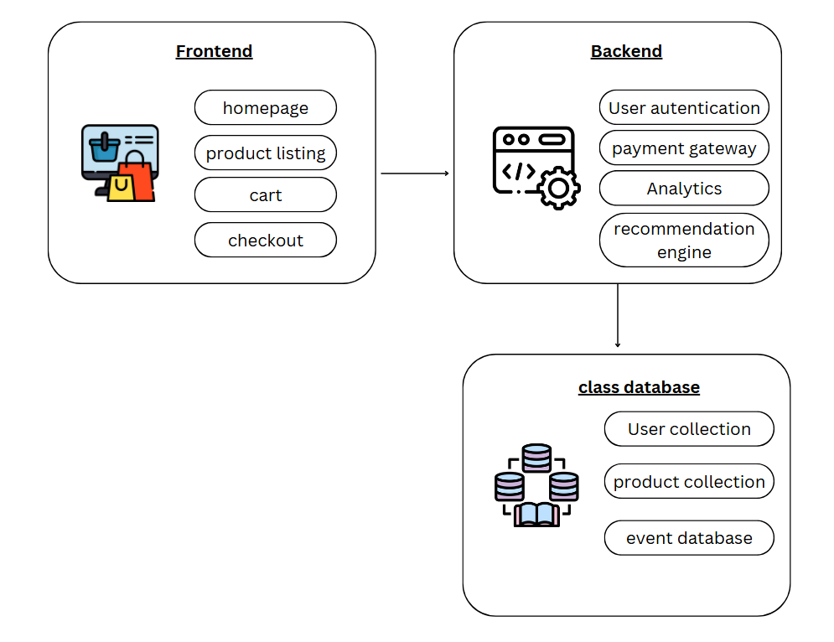
System Architecture

Slide 14
List of modules
User Authentication Module
Chatbot module
Product Management Module
4. Order Management Module
5. Admin Dashboard Module

Slide 15
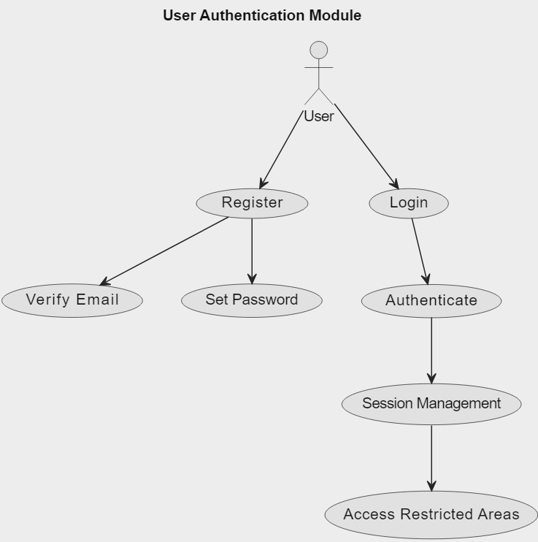
User Authentication Module

Slide 16
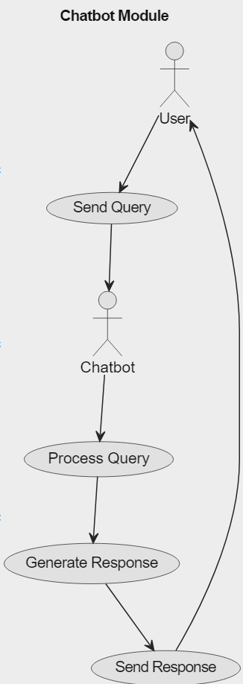
Chatbot Module

Slide 17
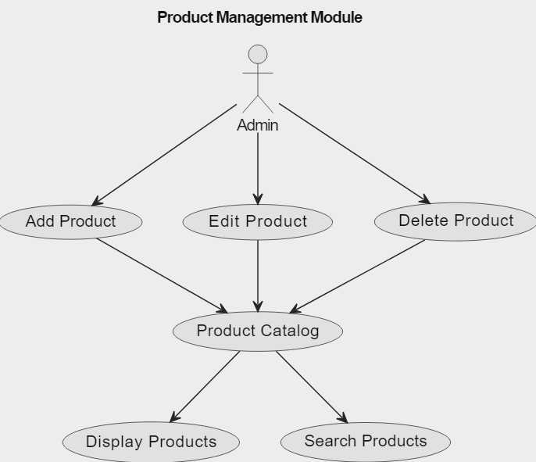
Product management module:

Slide 18
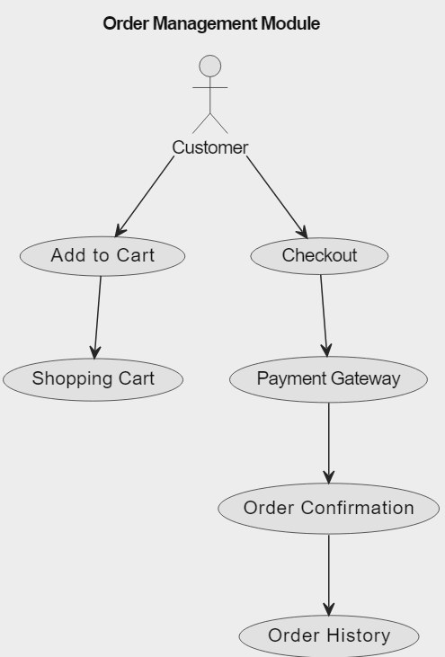
Order management module:

Slide 19
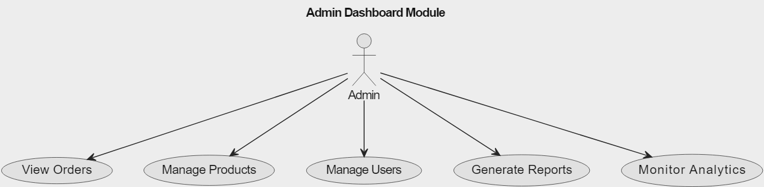
Admin dashboard Module:

Slide 20
Software Testing: Event Assistant Chatbot Website
The Event Assistant Chatbot website underwent comprehensive testing using Selenium to verify its functionality, usability, and performance. The purpose of this testing was to ensure that the chatbot meets the intended user experience goals and operates smoothly under various conditions. Functional testing was conducted to confirm that core features, such as sending messages, responding to commands (like "Participate" and "Arrange"), and handling both long and empty inputs, work as expected. All functional test cases passed successfully, indicating that the chatbot performs its core tasks reliably.
Usability testing focused on the chatbot’s responsiveness and user interface. Tests included verifying the chatbot's adaptability across devices, the alignment and accessibility of buttons, and ease of input. Minor accessibility issues were found, particularly with screen reader compatibility, which could be improved to enhance the experience for users with disabilities. Performance testing involved measuring the chatbot's response times under both normal and high-load conditions. The chatbot consistently met acceptable response times, averaging 1.8 seconds under normal load and remaining under 5 seconds even with simulated high load.

Slide 21

Visualization of Results

Slide 22
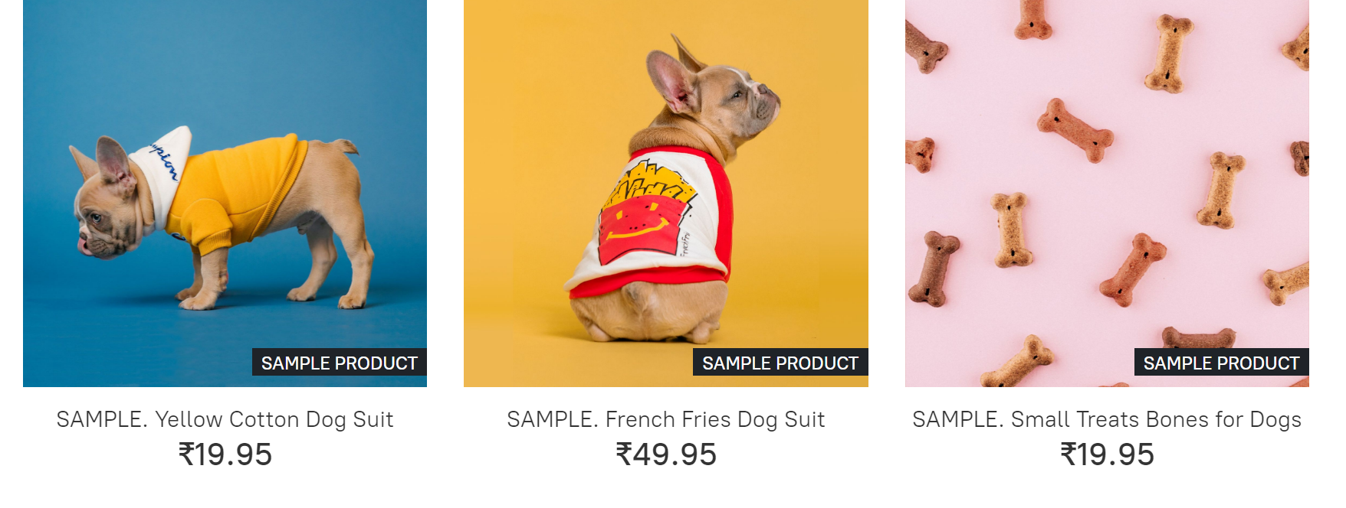
Visualization of Results

Slide 23
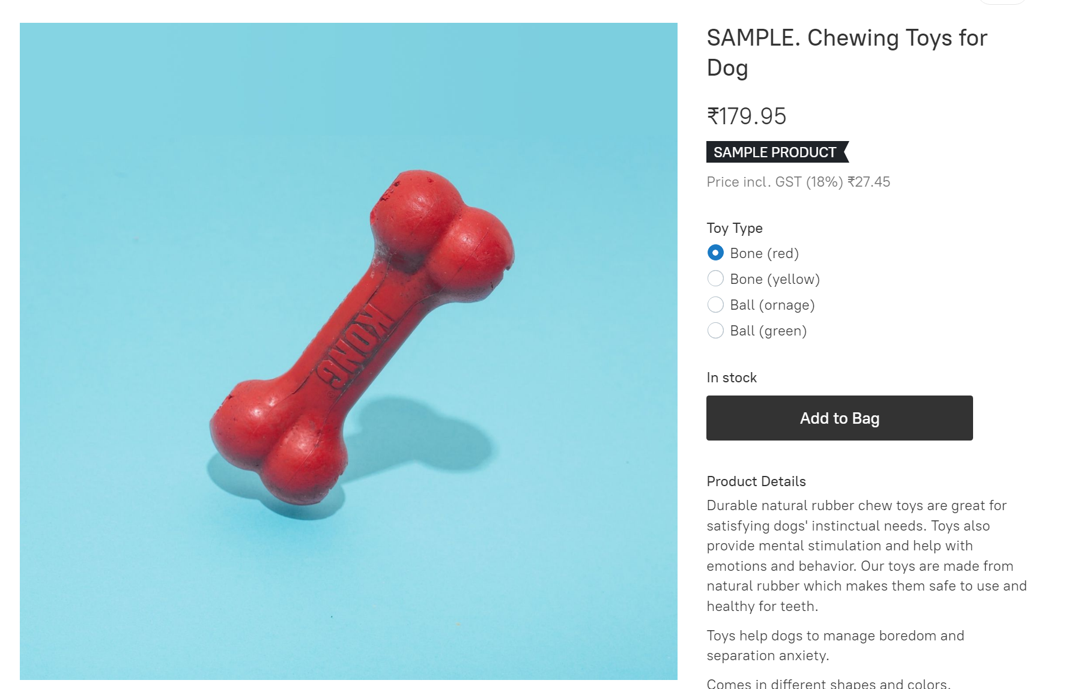
Visualization of Results

Slide 24
Result and Discussion
The platform successfully demonstrated the potential of AI in enhancing the online shopping experience. The recommendation system, powered by advanced machine learning algorithms, accurately predicted user preferences, leading to increased sales and customer satisfaction. The chatbot, integrated seamlessly into the platform, provided efficient customer support, resolving queries and issues promptly. Overall, the project highlights the significant impact of AI on modern e-commerce, paving the way for future innovations in the industry.

Slide 25
Conclusions
The project successfully developed an AI-powered e-commerce platform that caters to the specific needs of cat owners. By leveraging advanced technologies like machine learning and natural language processing, the platform offers personalized product recommendations, efficient customer support, and a seamless shopping experience. The integration of AI has significantly enhanced user satisfaction and business performance. Future work may involve exploring more sophisticated AI techniques to further optimize the platform and provide even more tailored experiences to customers.

Slide 26
References.
[1] Li, Y., & Liu, H. (2023). A Survey of AI-Powered E-commerce: From Recommendation Systems to Chatbots. IEEE Transactions on Knowledge and Data Engineering, 35(12), 5678-5692.
[2] Singh, A., & Kumar, S. (2022). Enhancing E-commerce Customer Experience Through AI-Powered Chatbots. International Journal of Intelligent Systems, 37(1), 23-45.
[3]Chen, H., & Zhang, X. (2021). Personalized Product Recommendations: A Deep Learning Approach. ACM Transactions on Information Systems, 39(4), Article 32.
[4] Wang, Y., & Yang, Y. (2020). AI-Powered Inventory Management: A Review. Journal of Industrial Information Integration, 21, 100168.

Slide 27
Thank You

